Slide 1
Digital Security Principles
MODULE 01
Samuel OCEN
E MAIL: - samuel.ocen@mmu.ac.ug
samuel.ocen@student.uonbi.ac.ke
MOB: +256(0)775 679 505
+256(0)706 109 393

Slide 2
A definition of computer security
Computer security: The protection afforded to an automated information system in order to attain the applicable objectives of preserving the integrity, availability and confidentiality of information system resources (includes hardware, software, firmware, information/data, and telecommunications)
NIST 1995

Slide 3
Three key objectives (the CIA triad)
Confidentiality
Data confidentiality: Assures that confidential information is not disclosed to unauthorized individuals
Privacy: Assures that individual control or influence what information may be collected and stored
Integrity
Data integrity: assures that information and programs are changed only in a specified and authorized manner
System integrity: Assures that a system performs its operations in unimpaired manner
Availability: assure that systems works promptly and service is not denied to authorized users

Slide 4
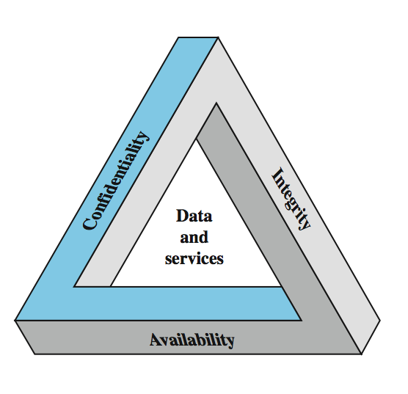
Key Security Concepts

Slide 5
Other concepts to a complete security picture
Authenticity: the property of being genuine and being able to be verified and trusted; confident in the validity of a transmission, or a message, or its originator
Accountability: generates the requirement for actions of an entity to be traced uniquely to that individual to support nonrepudiation, deference, fault isolation, etc

Slide 6
Levels of security breach impact
Low: the loss will have a limited impact, e.g., a degradation in mission or minor damage or minor financial loss or minor harm
Moderate: the loss has a serious effect, e.g., significance degradation on mission or significant harm to individuals but no loss of life or threatening injuries
High: the loss has severe or catastrophic adverse effect on operations, organizational assets or on individuals (e.g., loss of life)

Slide 7
Examples of security requirements: Confidentiality
Student grade information is an asset whose confidentiality is very high
The US FERPA Act: grades should only be available to students, their parents, and their employers (when required for the job)
Student enrollment information: may have moderate confidentiality rating; less damage if enclosed
Directory information: low confidentiality rating; often available publicly

Slide 8
Examples of security requirements: Integrity
A hospital patient’s allergy information (high integrity data): a doctor should be able to trust that the info is correct and current
If a nurse deliberately falsifies the data, the database should be restored to a trusted basis and the falsified information traced back to the person who did it
An online newsgroup registration data: moderate level of integrity
An example of low integrity requirement: anonymous online poll (inaccuracy is well understood)

Slide 9
Examples of security requirements: Availability
A system that provides authentication: high availability requirement
If customers cannot access resources, the loss of services could result in financial loss
A public website for a university: a moderate availably requirement; not critical but causes embarrassment
An online telephone directory lookup: a low availability requirement because unavailability is mostly annoyance (there are alternative sources).

Slide 10
Challenges of computer security
Computer security is not simple
One must consider potential (unexpected) attacks
Procedures used are often counter-intuitive
Must decide where to deploy mechanisms
Involve algorithms and secret info (keys)
A battle of wits between attacker / admin
It is not perceived on benefit until fails
Requires constant monitoring
Too often an after-thought (not integral)
Regarded as impediment to using system

Slide 11
A model for computer security
Table 1.1 and Figure 1.1 show the relationship
Systems resources
Hardware, software (OS, apps), data (users, system, database), communication facilities and network (LAN, bridges, routers, …)
Our concern: vulnerability of these resources (corrupted, unavailable, leaky)
Threats exploit vulnerabilities
Attack is a threat that is accrued out
Active or passive; from inside or from outside
Countermeasures: actions taken to prevent, detect, recover and minimize risks

Slide 12
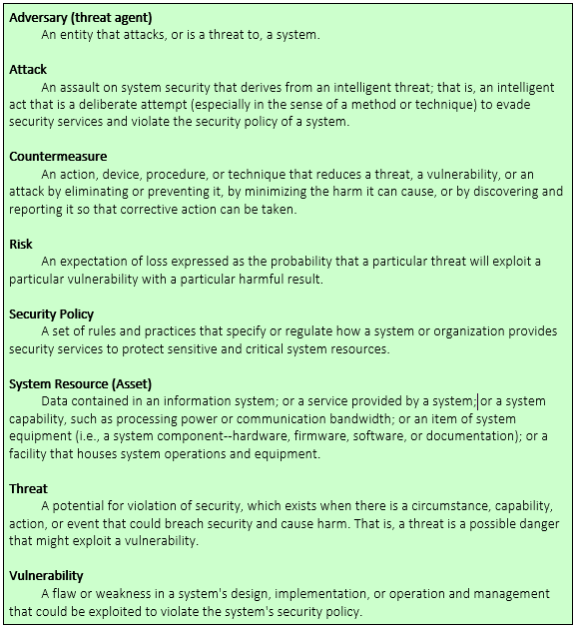
Computer Security Terminology.

Slide 13
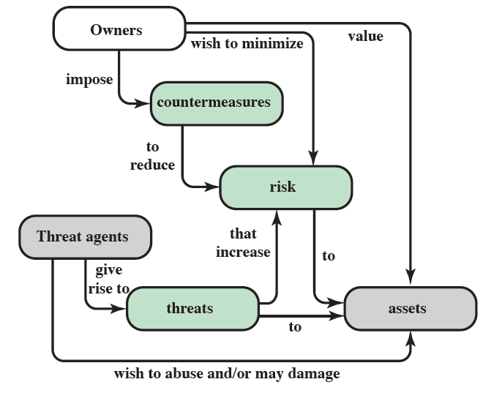
Security Concepts and Relationships

Slide 14
Threat consequences
Unauthorized disclosure: threat to confidentiality
Exposure (release data), interception, inference, intrusion
Deception: threat to integrity
Masquerade, falsification (alter data), repudiation
Disruption: threat to integrity and availability
Incapacitation (destruction), corruption (backdoor logic), obstruction (infer with communication, overload a line)
Usurpation: threat to integrity
Misappropriation (theft of service), misuse (hacker gaining unauthorized access)

Slide 15
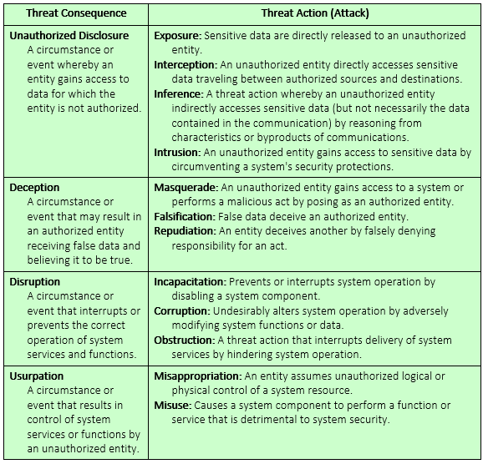
Threat consequences (tabular form)

Slide 16
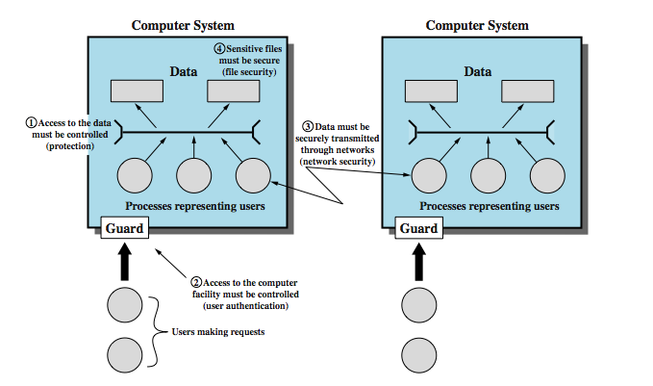
SCOPE OF COMPUTER SECURITY

Slide 17
Principles that Govern Digital Security
Govern: Identifying and managing security risks.
Protect: Implementing controls to reduce security risks.
Detect: Detecting and understanding digital security events to identify digital security incidents.
Respond: Responding to and recovering from digital security incidents.

Slide 18
Objectives
Definition and Concepts of Digital Security
Information Security
Objectives of System Security

Slide 19
Definition and Concepts
Digital Security: the collective term that describes the resources employed to protect your online identity, data, and other assets.
Concepts:

